Slide 1
Emotion From Text
Submitted By:
Padma Dhar (2018201011)
Divyanshi Kushwaha(2018201046)
Priya Upadhyay(2018202012)
Himani Gupta(2018202014)

Slide 2
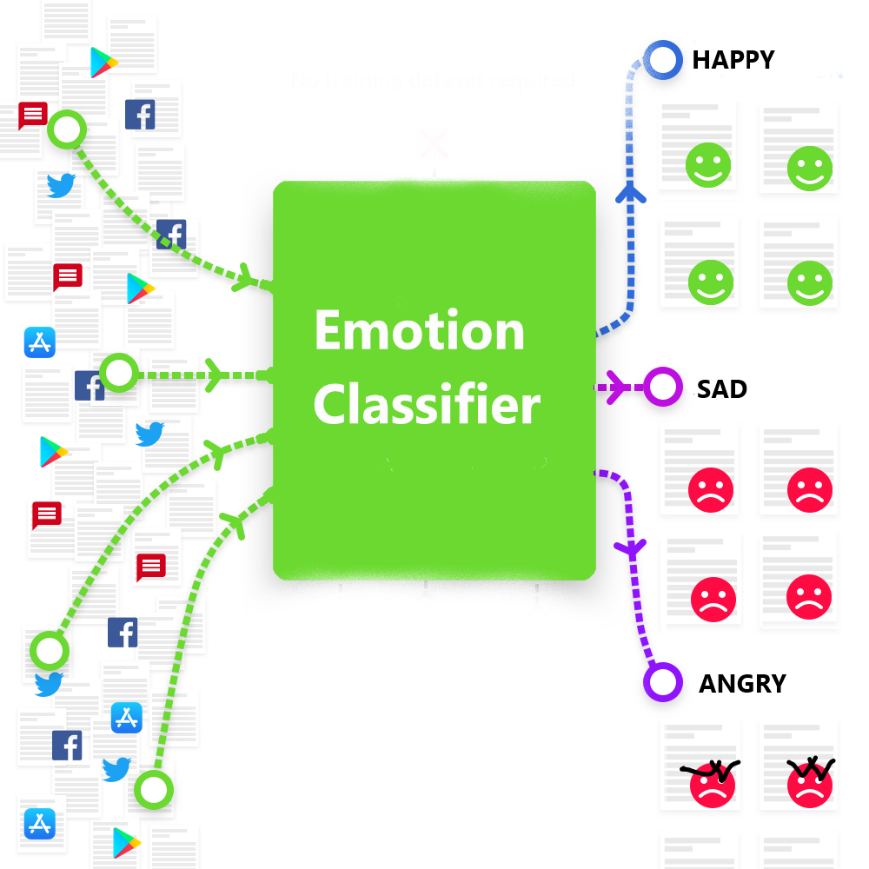

Slide 3
Machine Learning approach for text classification
Input Text
Pre-processing
Word Embedding
Machine Learning Model
Emotion

Slide 4
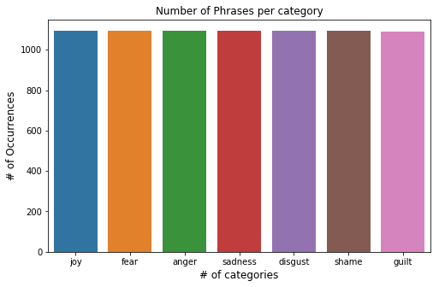
Dataset Visualization
Dataset for single emotion classification

Slide 5
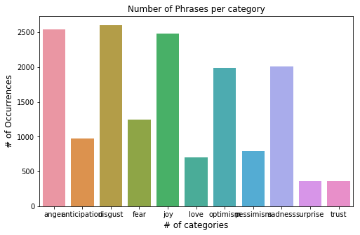
Dataset Visualization
Dataset for multiple emotion classification

Slide 6
Machine Learning approach for text classification
Input Text
Pre-processing
Word Embedding
Machine Learning Model
Emotion

Slide 7
Pre-processing
Pre-processing of data involves cleaning of dataset, using various techniques.
Dealt with
numeric values
Stop words in English language(the, and, etc)
NaN Values
Special Characters
etc

Slide 8
Pre-processing(Contd.)
Lemmatization/ Stemming
Running
Run
Danced
Dance

Slide 9
Pre-processing(Contd.)
This
is
This is an amazing car
an
Amazing
Amazing
Amaze
Input Text
Car
Car
Car
Tokenization
Removing stop words
Lemmatization

Slide 10
Machine Learning approach for text classification
Input Text
Pre-processing
Word Embedding
Machine Learning Model
Emotion

Slide 11
Word Embedding
Word Representation
Similar representation for similar words
Words represented as a vector in predefined vector space
Types of word embedding
Sparse:
Bag of words(TF-IDF)
Dense:
Tokenizer API by Keras
GloVe(Global Vectors for Word Representation)
etc

Slide 12
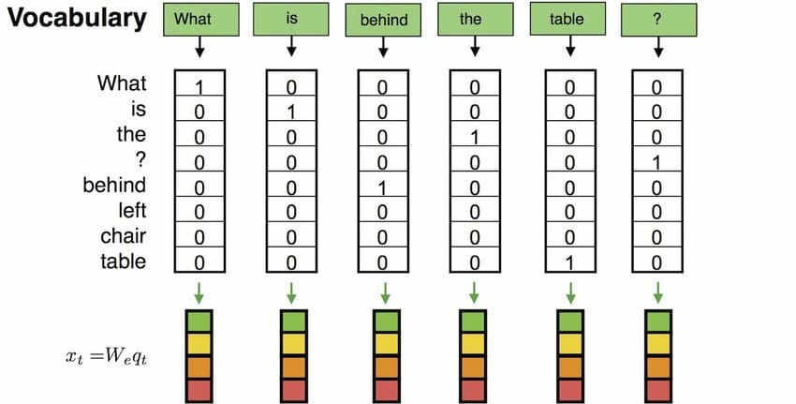
Bag of Words

Slide 13
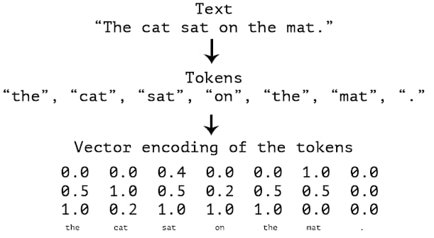
Tokenizer API by Keras

Slide 14
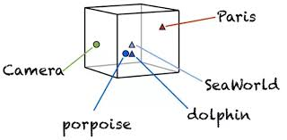
Vector Space for Words

Slide 15
Machine Learning approach for text classification
Input Text
Pre-processing
Word Embedding
Machine Learning Model
Emotion

Slide 16
Machine Learning Models
K- Nearest Neighbours
Naive Bayes
Long Short Term Memory
CNN LSTM
LSTM CNN

Slide 17
KNN using TFIDF
Can be used for clustering text with similar emotions.
Before applying KNN we pre-processed the text with the technique of TFIDF(Term frequency inverse document frequency)
Using TFIDF, a text can be represented as vector in a vector space
Similarity metric used in KNN is the distance between the two points in the vector space.

Slide 18
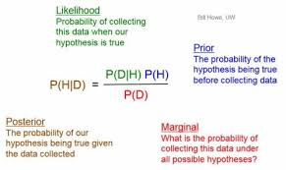
Naïve Bayes
For every emotion, we calculate the prior probability.
Find the likelihood probability with each phrase for each emotion.
Put this in Bayes formula and calculate posterior probability.

Slide 19
LSTM(Long Short Term Memory)
LSTM has a memory that remembers previous data from input and makes decision based on that knowledge.
This property of LSTM makes it a good candidate for extracting emotion from text.
In data pre-processing, we cleaned the data, and embedded it using tokenizer API of keras.

Slide 20
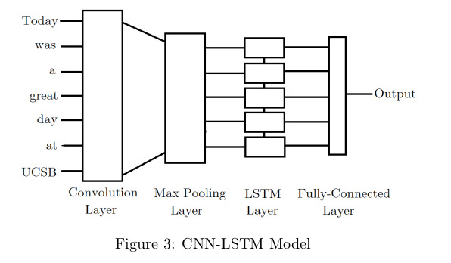
CNN LSTM

Slide 21
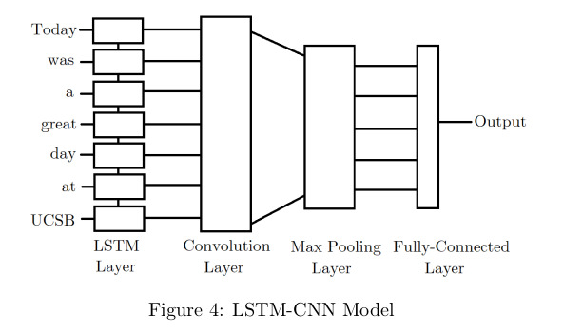
LSTM CNN

Slide 22
Multi-label Classification
Naïve Bayes
Combined One vs Rest approach with Naïve Bayes, to classify text into multiple emotion classes.
K-nearest neighbour
Predicts multiple emotion for a given text based on its neighbours.

Slide 23
Performance of various models
Model Name | Training Accuracy | Testing Accuracy
LSTM | 82% | 52%
Naive Bayes | 80% | 53.1%
CNN-LSTM | 82% | 49.11%
LSTM-CNN | 68.9% | 48.0%
K-nearest neighbour | 65.8% | 38.6%

Slide 24
References
1. http://konukoii.com/blog/2018/02/19/twitter-sentiment-analysis-using-combined-lstm-cnn-models/
2. https://towardsdatascience.com/machine-learning-text-processing-1d5a2d638958
3. https://towardsdatascience.com/multi-label-text-classification-with-scikit-learn-30714b7819c5
4. https://nlp.stanford.edu/projects/glove/
5. https://realpython.com/python-keras-text-classification/
6. https://sebastianraschka.com/Articles/2014_naive_bayes_1.html
7. https://towardsdatascience.com/text-classification-using-k-nearest-neighbors-46fa8a77acc5

Slide 25


